Slide 1
Titanic - Who will survive?
Jaden Wong and Jason Cheng

Slide 2
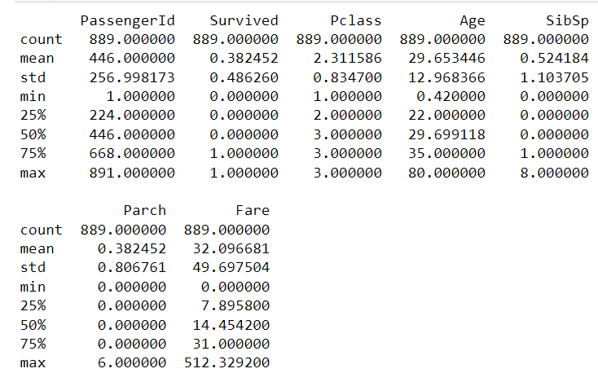
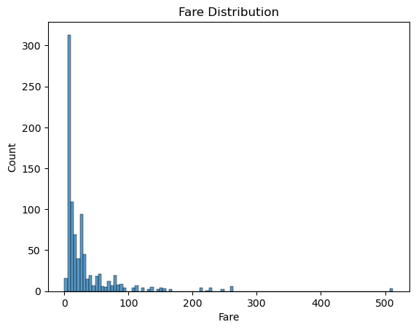
Cleaning
Fill ages that are NaN with the average of Ages
Drop rows where Fare is NaN and Embarked is NaN
Change male to 0 and female to 0 for machine learning models
Drop unnecessary columns (Cabin, Name, Ticket)

Slide 3

Exploratory Data Analysis Anova F-test
Used ANOVA f_test to see if there is a statistically significant difference between the means of certain attributes and ticket class.
At a alpha level of 0.01, the p-values for SibSp and Parch is rejected
Age and Fare is accepted, which indicated a significant difference in average fare cost and Age relative to the ticket class.

Slide 4
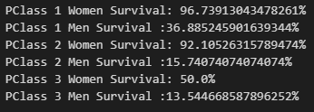
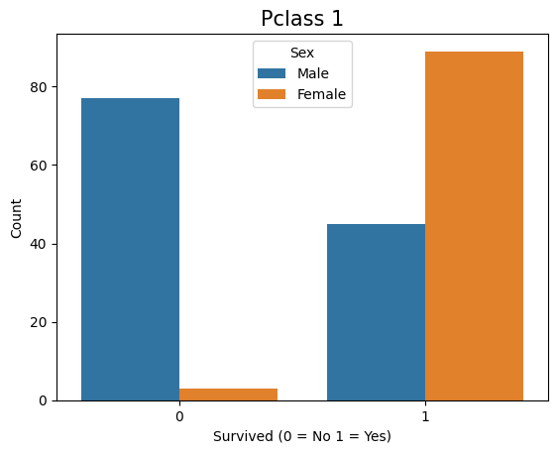
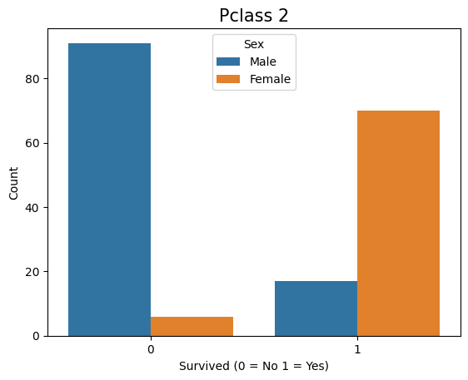
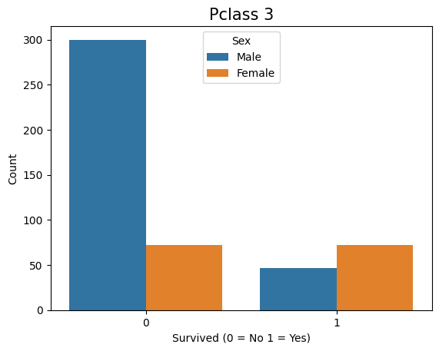
Gender vs Survival Rate
People in higher classes are being prioritized for rescuing compared to lower classes
More females who survived than males and more males than females that did not survive

Slide 5
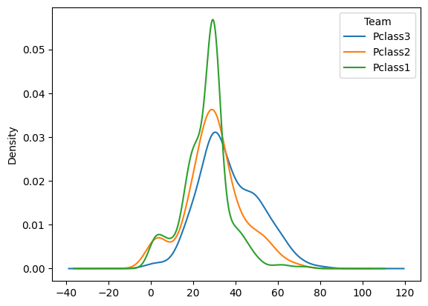
Kernel density estimation graph on Age and Pclass
Indicates distribution of ages in our data
Significant amount of passengers are adults between the ages 20-40

Slide 6

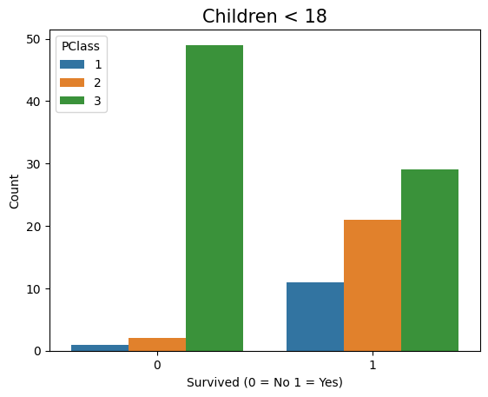
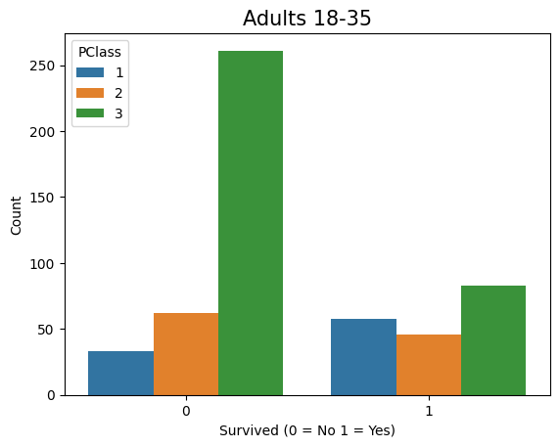
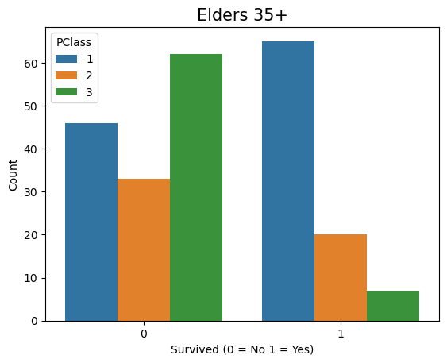
Age Vs Survival Rate
Split ages into 3 groups: (0,18),[18,-35), and 35+
Children overall had the highest survival rate at about 54%. Elders had about a 5% higher than adults
Elders had a significantly higher survival rate if they are Pclass 1 while children had the most in the other classes

Slide 7
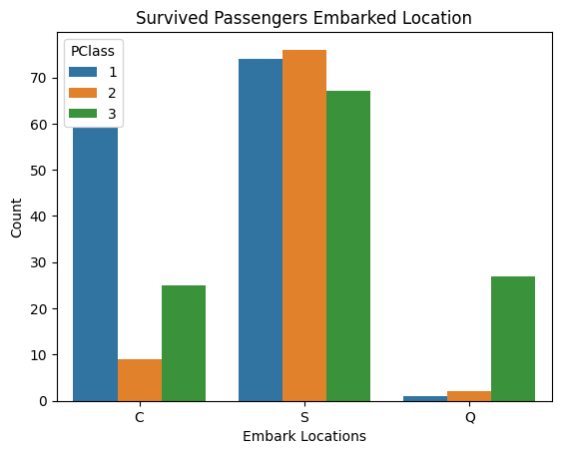
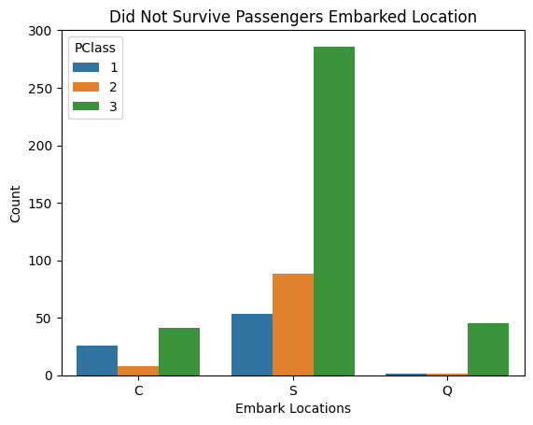
Port vs Survival Rate
Embark locations key is: C = Cherbourg, Q = Queenstown, S = Southampton
Embarking from Southampton has overall a much higher survival rate with all the amount of passengers that survive are around the same for all Pclasses

Slide 8
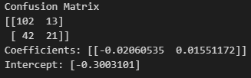

Model 1: Logistic Regression on Age and Fare
F1 score of 0.433: too low to be a reliable predictor for passenger survival
recall score of 0.33: lot of false negatives, where it predicts a passenger did not survive when they did
Accuracy of .69: decent accuracy mostly due to more passengers not surviving

Slide 9

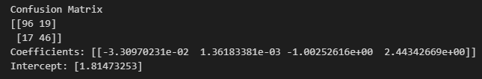
Model 2: Logistic Regression on Age, Fare, Sex , Pclass
F1 score of 0.71875: Does well at predicting Survival rates
Less false negative predictions at the cost of a little true negative guesses,

Slide 10


Model 3: Decision tree on Pclass, Sex, Embarked, Age
Slightly higher F1 score than model 2 with a score of 0.7401
Difference between model 2 and 3 in F1 score is not large enough to claim that this model will always be more performant than model 2
Better job at predicting true negatives and making less false positives
Performance on false negatives and true negatives is slightly worse than model 2

Slide 11
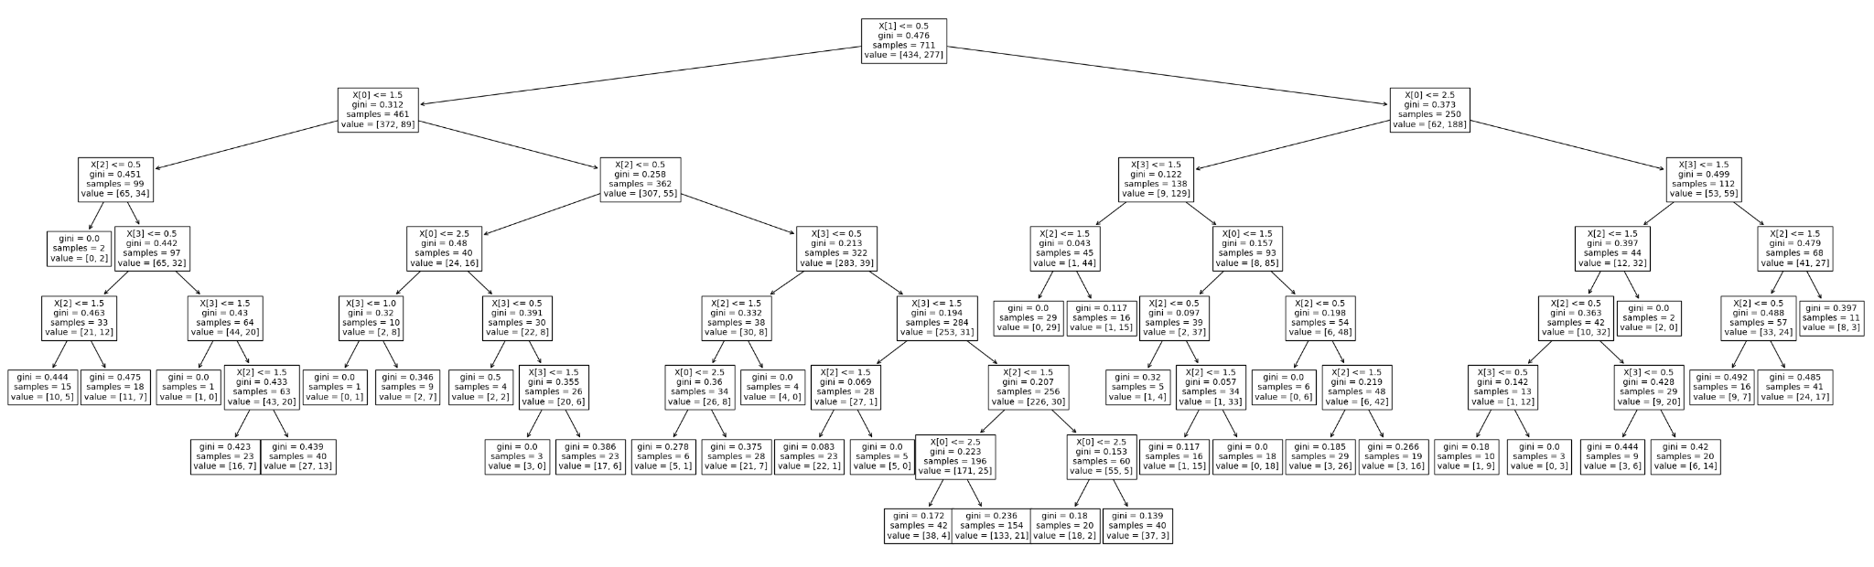
Model 3: Decision tree

Slide 12



Cross-validation on Model 1 and 2
Fold Lengths: 10
Model 1: Not too overfitting, but performance is not good from low f1 score and large variance
Small difference between cross-validation Models and splitting training set by 80% since they fall within 1 standard deviation
Model 1:
Model 2:
Model 3:

